Slide 1
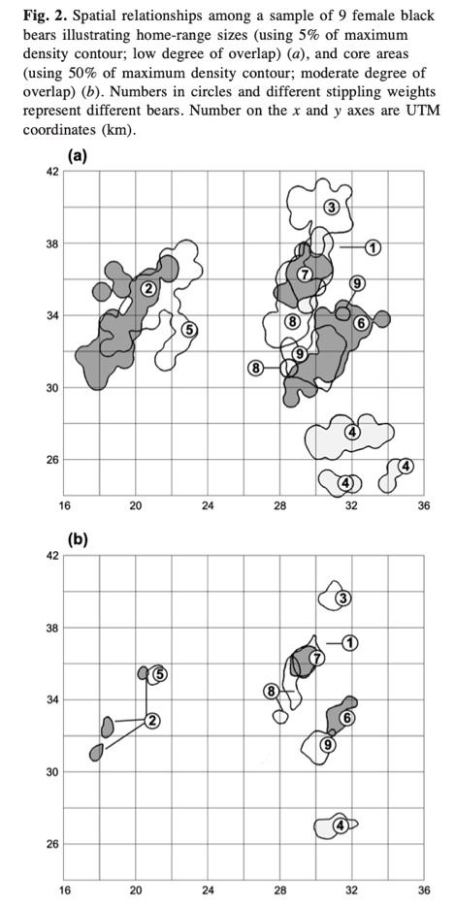
Black Bear
Schenk et al. 1998 – Genetic relatedness and home-range overlap among female black bears (Ursus americanus) in northern Ontario, Canada

Slide 2
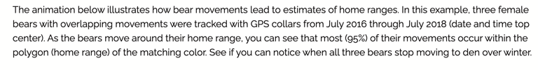
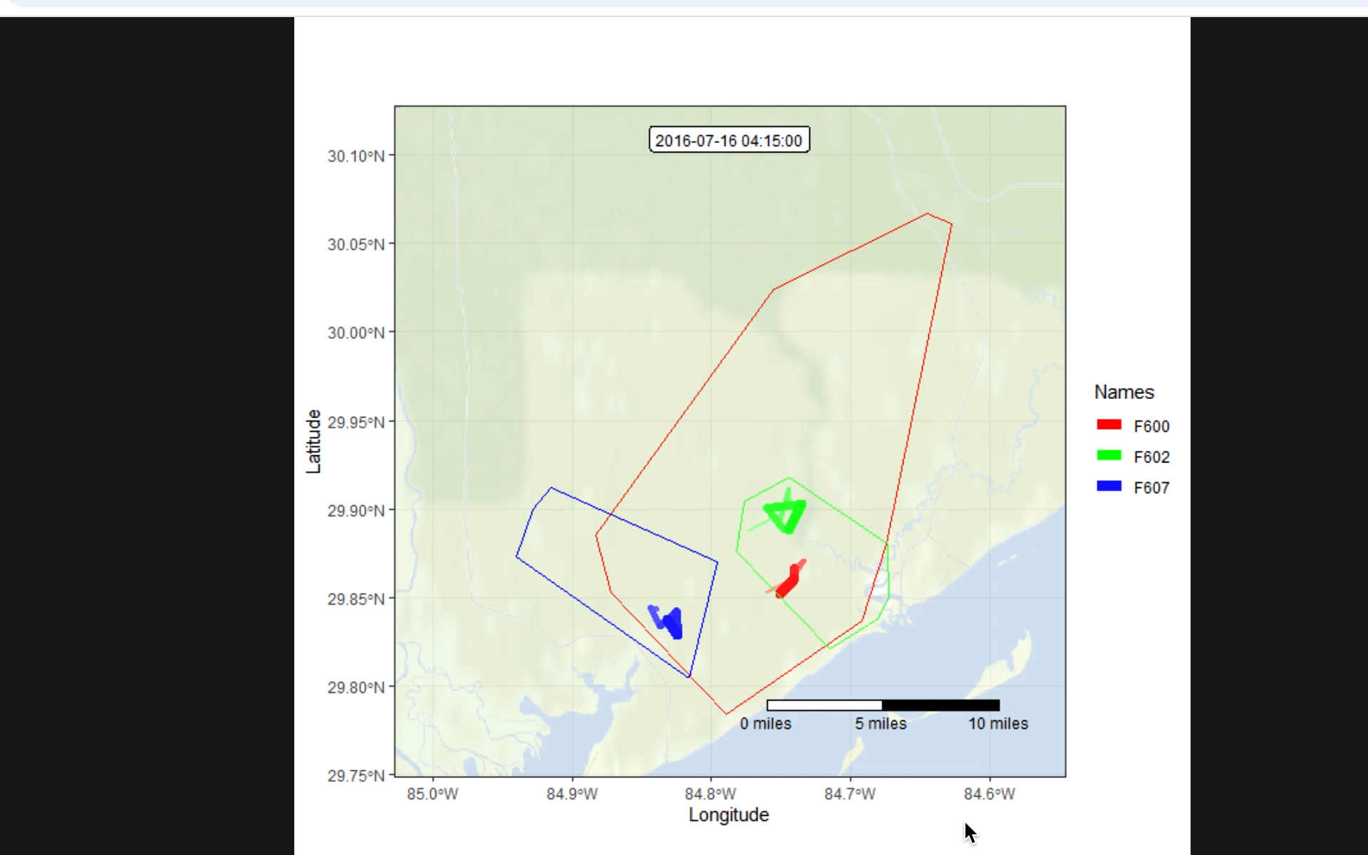
Black Bear
Florida Fish and Wildlife Conservation Commission (2016-2018). Tracking bears. Retrieved December 28, 2024, from https://myfwc.com/research/wildlife/terrestrial-mammals/bear/tracking/

Slide 3
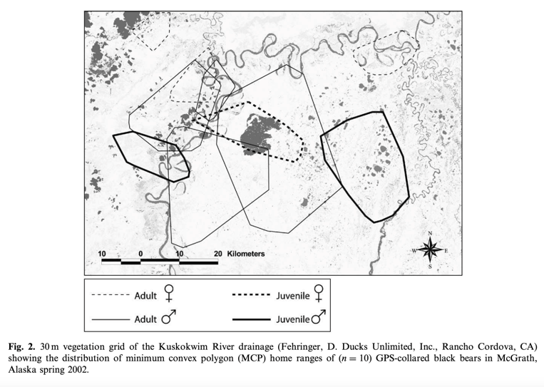
Black Bear
Garneau et al. 2008 – Habitat use by black bears in relation to conspecifics and competitors

Slide 4
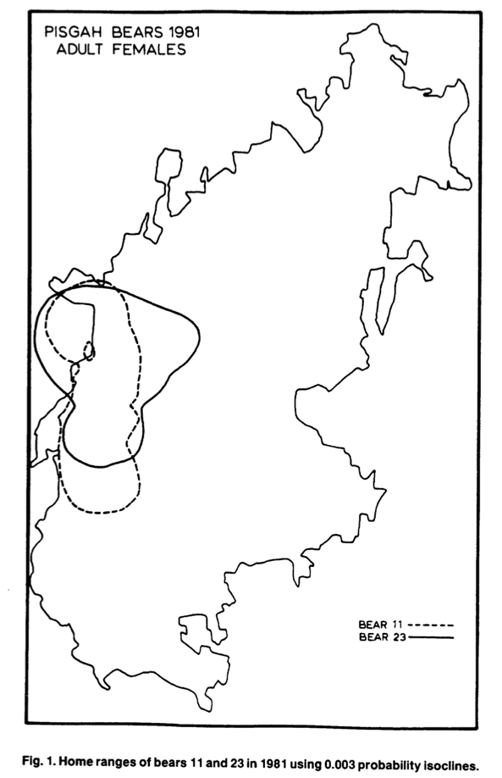
Black Bear
Powell 1987 – Black bear home range overlap in North Carolina and the Concept of Home Range Applied to Black Bears

Slide 5
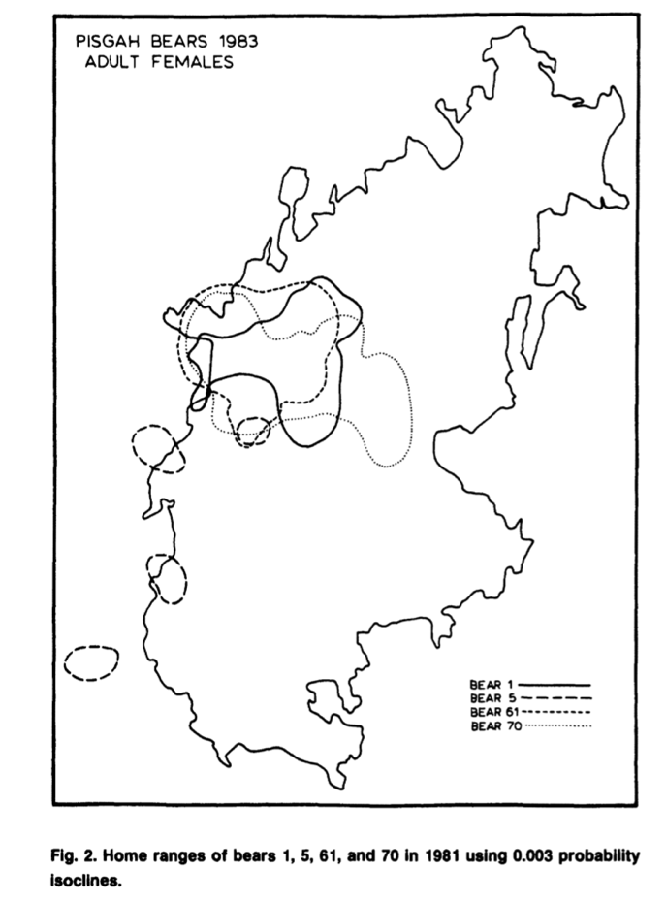
Black Bear
Powell 1987 – Black bear home range overlap in North Carolina and the Concept of Home Range Applied to Black Bears

Slide 6
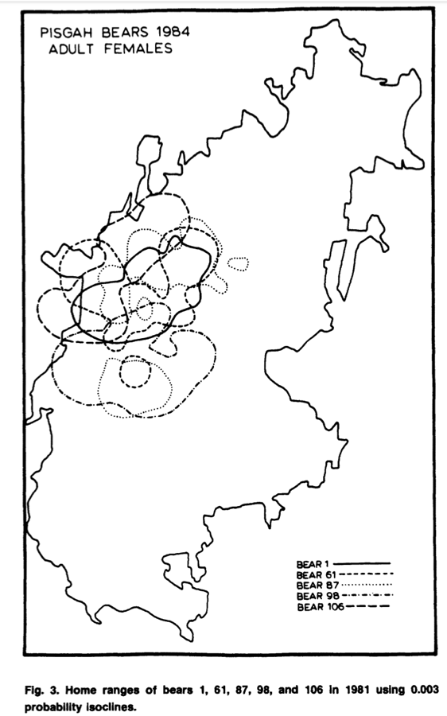
Black Bear
Powell 1987 – Black bear home range overlap in North Carolina and the Concept of Home Range Applied to Black Bears

Slide 7
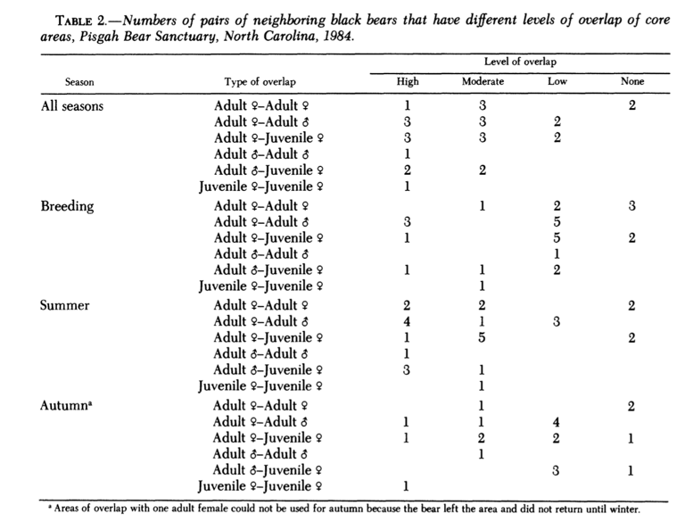
Black Bear
Horner & Powell 1990 – Internal Structure of Home Ranges of Black Bears and Analyses of Home-Range Overlap
Major findings:

Slide 8
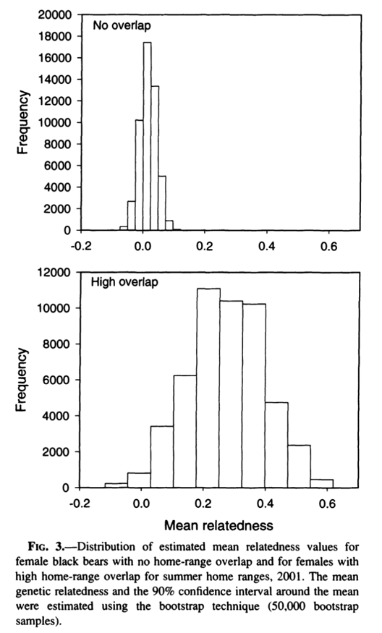
Black Bear
Moyer et al. 2006 – Does Genetic Relatedness Influence Space Use Pattern? A Test on Florida Black Bears

Slide 9
References
Powell, R. A. (1987). Black bear home range overlap in North Carolina and the concept of home range applied to black bears. Bears: Their Biology and Management, 7, 235-242.
Horner, M. A., & Powell, R. A. (1990). Internal structure of home ranges of black bears and analyses of home-range overlap. Journal of Mammalogy, 71(3), 402-410.
Moyer, M. A., McCown, W. J., Eason, T. H., & Oli, M. K. (2006). Does genetic relatedness influence space use pattern? A test on Florida black bears. Journal of Mammalogy, 87(2), 255-261.
Schenk, A., Obbard, M. E., & Kovacs, K. M. (1998). Genetic relatedness and home-range overlap among female black bears (Ursus americanus) in northern Ontario, Canada. Canadian Journal of Zoology, 76(8), 1511-1519
Garneau, D. E., Boudreau, T., Keech, M., & Post, E. (2008). Habitat use by black bears in relation to conspecifics and competitors. Mammalian Biology - Zeitschrift für Säugetierkunde, 73(1), 48–57.

